Slide 1

Electronic Devices
Lab Lecture 3
This document might contain some excerpts and pictures from various books and other sources. The author doesn’t claim any rights to the topics discussed in this video. This topics has been presented in a way to help out students in BRAC university, Bangladesh

Slide 2
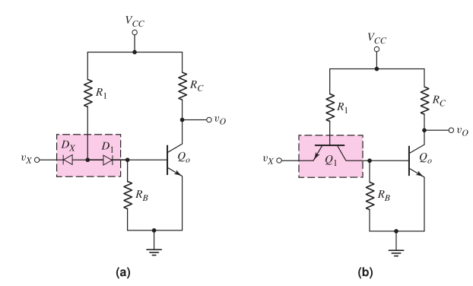
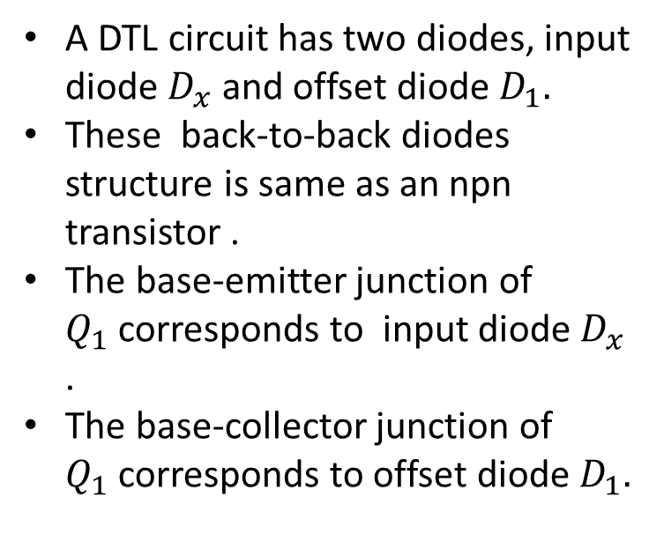
Transistor-Transistor Logic Gates
A DTL circuit has two diodes, input diode $D_{x}$and offset diode $D_{1}.$
These back-to-back diodes structure is same as an npn transistor .
The base-emitter junction of $Q_{1}$corresponds to input diode $D_{x}$ .
The base-collector junction of $Q_{1}$corresponds to offset diode $D_{1}.$
Figure : (a) Basic DTL gate and (b) basic TTL gate

Slide 3
Transistor-Transistor Logic Gates
There are three output format of TTL circuits
Open collector.
Totem pole
Tristate output.
Figure : (a) Basic DTL gate and (b) basic TTL gate

Slide 4
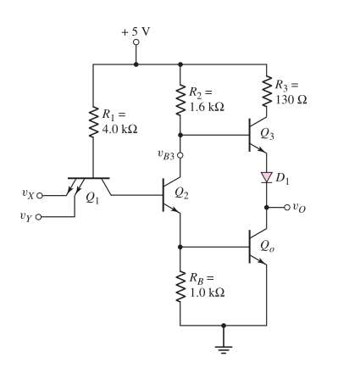
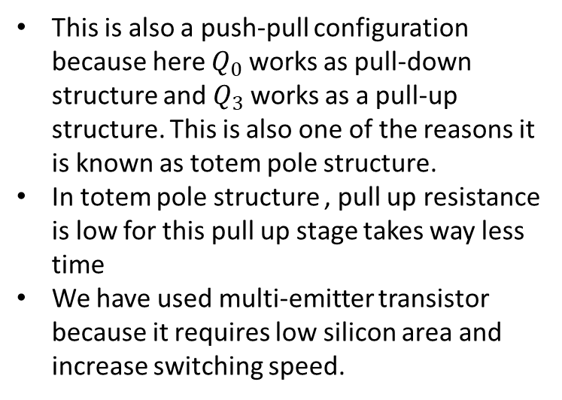
Totem Pole TTL Gates
This is also a push-pull configuration because here $Q_{0}$works as pull-down structure and $Q_{3}$works as a pull-up structure. This is also one of the reasons it is known as totem pole structure.
In totem pole structure , pull up resistance is low for this pull up stage takes way less time
We have used multi-emitter transistor because it requires low silicon area and increase switching speed.

Slide 5
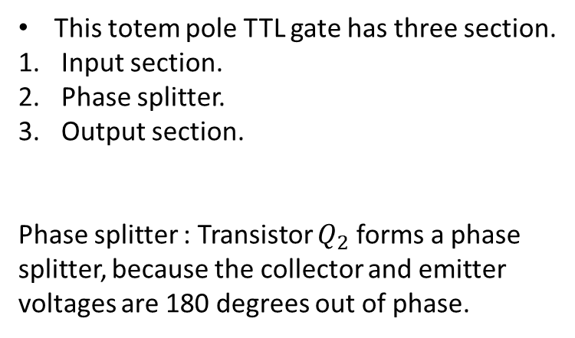
Totem Pole TTL Gates
This totem pole TTL gate has three section.
Input section.
Phase splitter.
Output section.
Phase splitter : Transistor $Q_{2}$ forms a phase splitter, because the collector and emitter
voltages are 180 degrees out of phase.

Slide 6
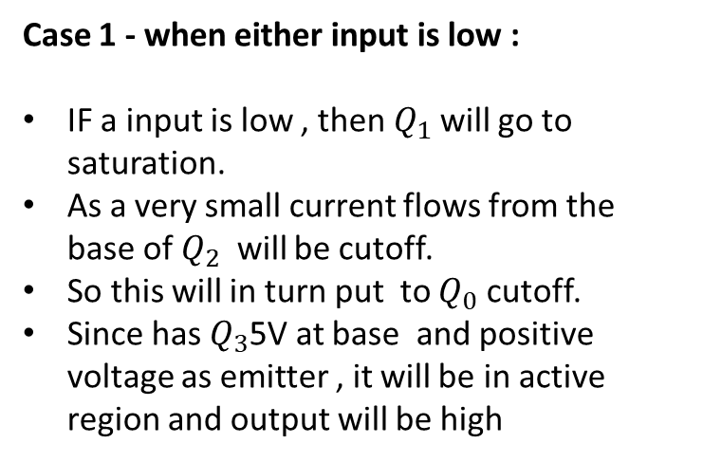
Totem Pole TTL Gates
Case 1 - when either input is low :
IF a input is low , then $Q_{1}$will go to saturation.
As a very small current flows from the base of $Q_{2}$ will be cutoff.
So this will in turn put to $Q_{0}$ cutoff.
Since has $Q_{3}$5V at base and positive voltage as emitter , it will be in active region and output will be high

Slide 7
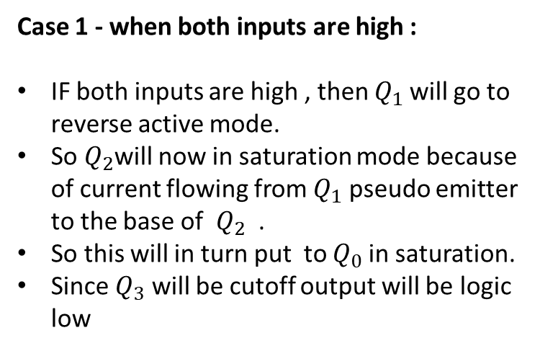
Totem Pole TTL Gates
Case 1 - when both inputs are high :
IF both inputs are high , then $Q_{1}$will go to reverse active mode.
So $Q_{2}$will now in saturation mode because of current flowing from $Q_{1}$ pseudo emitter to the base of $Q_{2}$ .
So this will in turn put to $Q_{0}$in saturation.
Since $Q_{3}$ will be cutoff output will be logic low

Slide 8
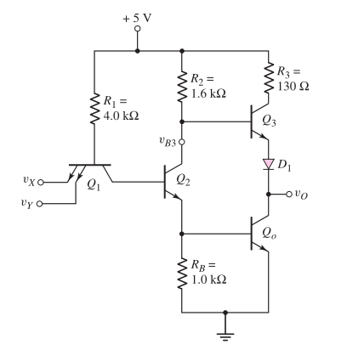
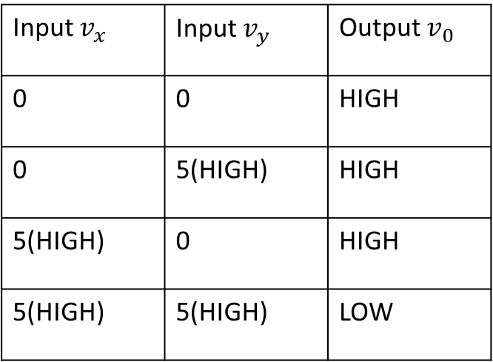
Totem Pole TTL NAND Gate
Input $v_{x}$ | Input $v_{y}$ | Output $v_{0}$
0 | 0 | HIGH
0 | 5(HIGH) | HIGH
5(HIGH) | 0 | HIGH
5(HIGH) | 5(HIGH) | LOW
Figure : Totem-pole TTL NAND gate

Slide 9
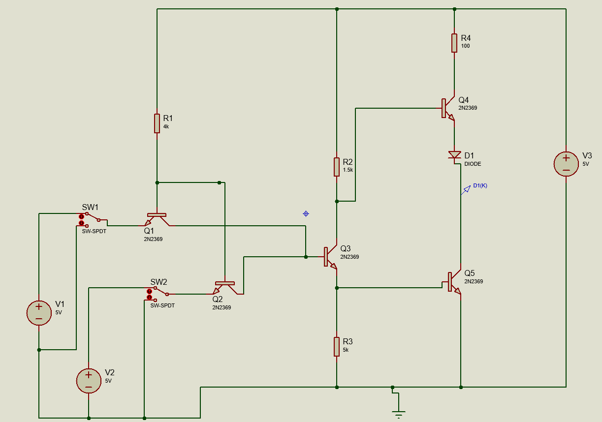
Simulation
Figure : Schematic of Totem Pole TTL NAND gate

